Slide 1

Breast Cancer Prediction
Using Machine Learning
Submitted by:-
Jashandeep Kaur

Slide 2

You are made up of trillions of cells which over your lifetime normally grow and divide as needed. When cells are abnormal or get old, they usually die.
Cancer starts when something goes wrong in this process and your cells keep making new cells and old or abnormal ones don't die when they should.
Breast cancer is one of the most common cancers among women worldwide, representing majority of new cancer cases and cancer-related deaths according to global statistics, making it significant public health problem in today’s society.
Introduction to Breast Cancer

Slide 3

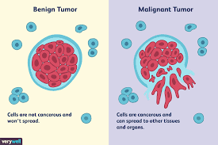
Classification of Tumor
Cancer can develop anywhere in the body and is named for the part of the body where it started. For instance, breast cancer that starts in the breast is still called breast cancer even if it spreads (metastasizes) to other parts of the body. A tumor is a main cause of cancer. A tumor is a lump or growth.
Lumps that are not cancer are called benign
Lumps that are cancer are called malignant

Slide 4

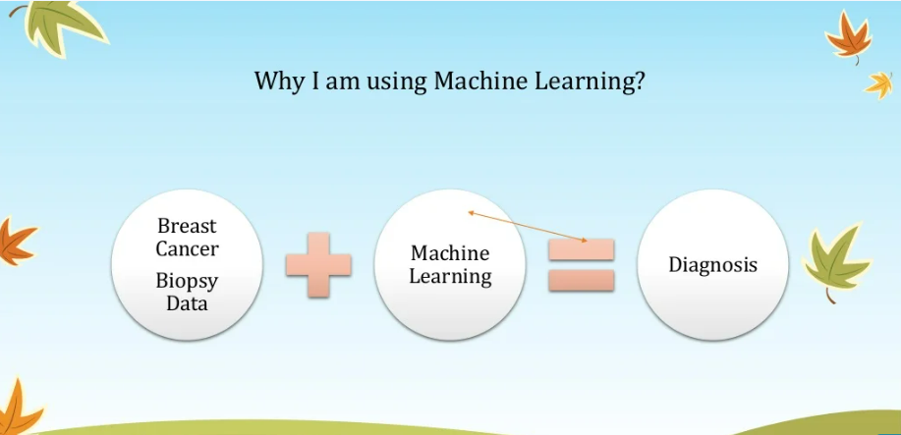
Role of Machine Learning in Breast Cancer Prediction
Machine learning techniques can bring a large contribute on the process of prediction and early diagnosis of breast cancer, became a research hotspot and has been proved as a strong technique. ML is a branch of artificial intelligence that is used to classify data based on models which have been developed and for predictive analytics, in particular breast cancer. In the case of the present study, we utilized ML algorithms and collected a scientific dataset of 569 breast cancer patients from Kaggle website and thereby interpreting results.

Slide 5
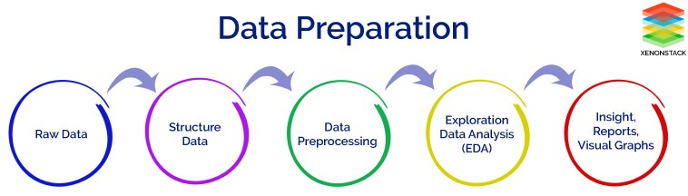

Slide 6



Attribute Information:
1)ID number 2) Diagnosis (M = malignant, B = benign) 3–32)
Ten real-valued features are computed for each cell nucleus:
radius (mean of distances from center to points on the perimeter)
texture (standard deviation of gray-scale values)
perimeter
area
smoothness (local variation in radius lengths)
compactness (perimeter² / area — 1.0)
concavity (severity of concave portions of the contour)
concave points (number of concave portions of the contour)
symmetry
fractal dimension (“coastline approximation” — 1)
The mean, standard error and “worst” or largest (mean of the three largest values) of these features were computed for each image, resulting in 30 features. For instance, field 3 is Mean Radius, field 13 is Radius SE, field 23 is Worst Radius.
Data Preparation

Slide 7

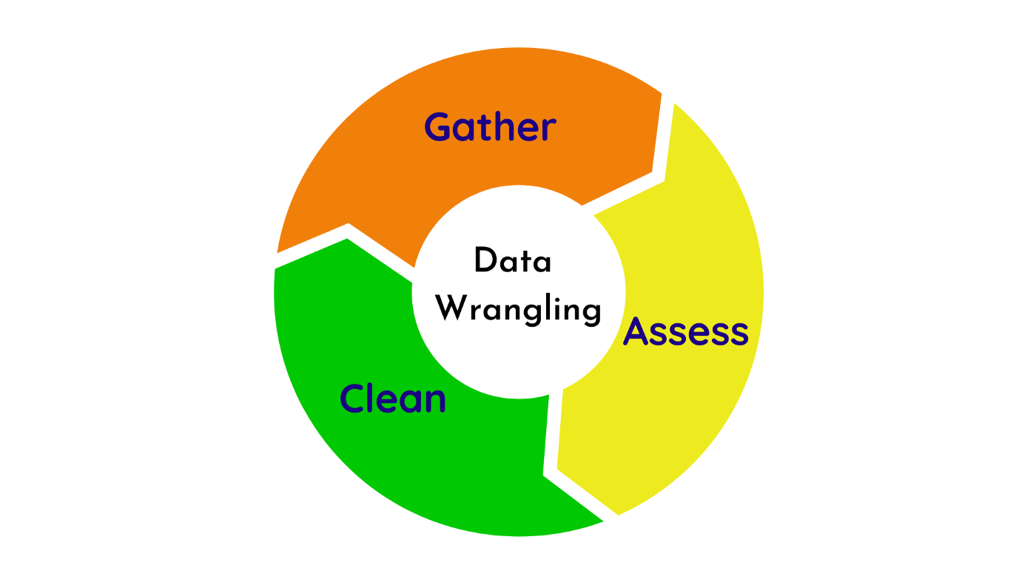
Data Wrangling
It is process of converting or mapping data from one raw form into another format to make it ready for further analysis.
Data pre-processing is also often called “data cleaning’’ or “data wrangling”. Like we can count the number of empty values (NaN, na) in each column and can drop unnecessary columns. By performing filtering, grouping, and selecting appropriate data, accuracy and performance of the model will be increased.

Slide 8

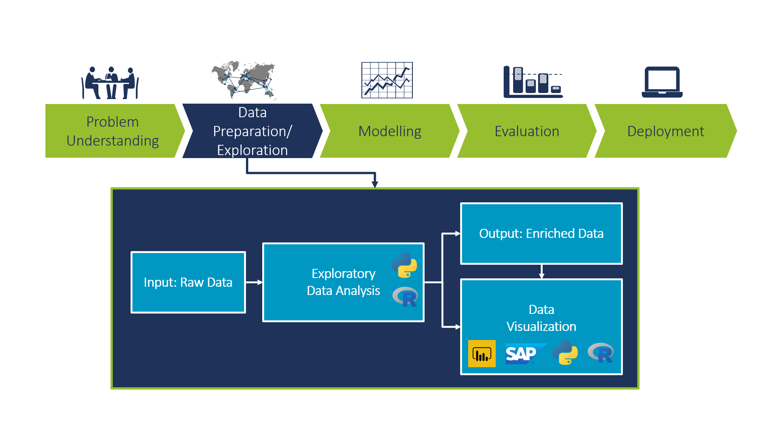
Exploratory Data Analysis refers to the critical process of performing initial investigations on data so as to discover patterns, to spot anomalies, to test hypothesis & to check assumptions with the help of summary statistics and graphical representations.

Slide 9

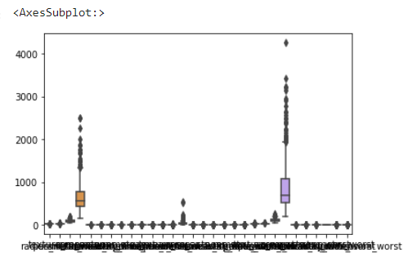
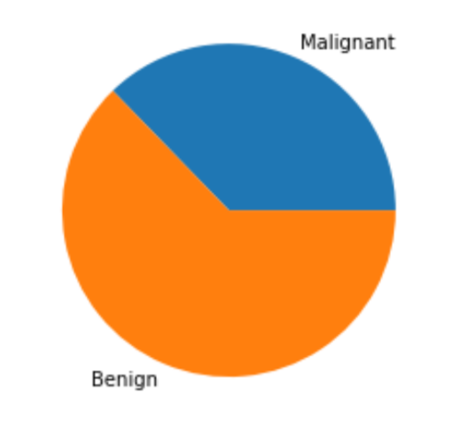
Visualizing data
Visualizing the data
Piechart
Boxplot for all columns

Slide 10
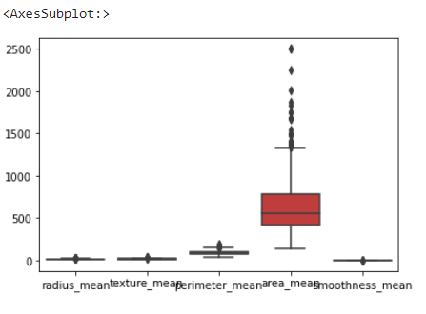
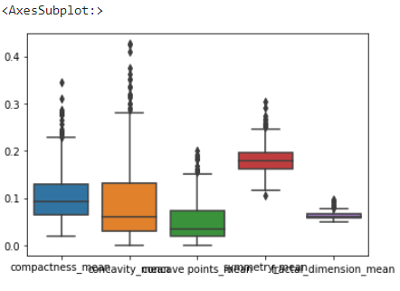
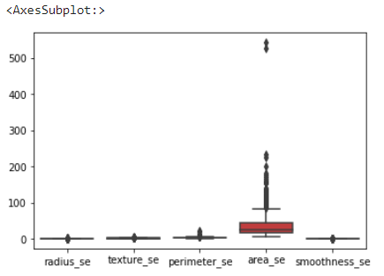
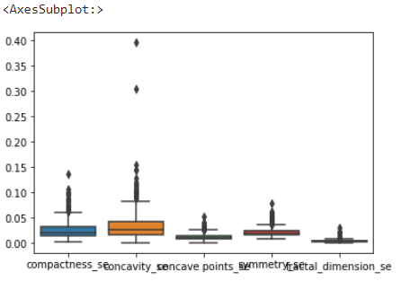
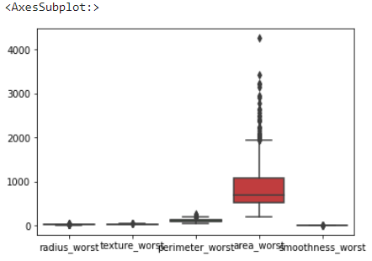
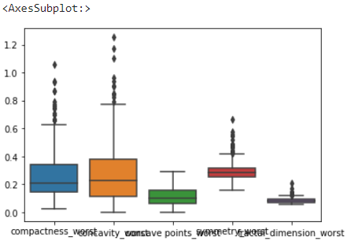
Boxplot for different pairs of columns

Slide 11

Curse of Dimensionality
We have total 30 features in our data set which predict whether the person is having Breast Cancer or not. But so many features will led to high dimensional spaces which is a curse on Machine Learning. This is known as Curse of dimensionality.
It is the problem caused by the exponential increase in volume associated with adding extra dimensions to Euclidean space. So we used Feature Engineering for overcoming this problem.

Slide 12

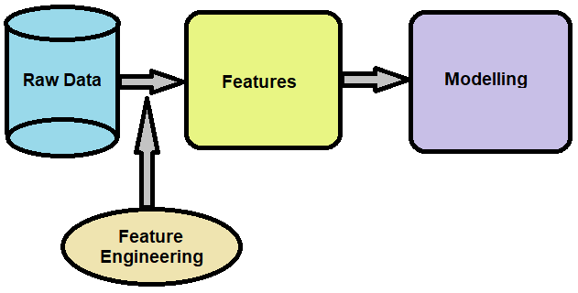
Feature Extraction
Feature extraction is a machine learning technique that leverages data with the goal of simplifying and speeding up data transformations while enhancing model accuracy also.
So we will use heatmaps to pick out the features which are most dependable on diagnosis column. We will divide our features into three different groups according to their dependency percentage.

Slide 13

It’s a statistical metric for measuring to what extent different variables are interdependent.
It is denoted by r and its values are between -1 and +1. A positive value for r indicates a positive association, and a negative value for r indicates a negative association.
By using corr() function , the correlation between two columns in dataframe can be achieved. This function tells us about how one column can influence the other.
Correlation of Columns

Slide 14

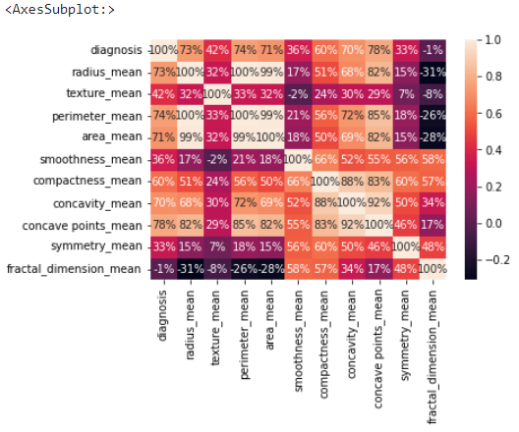
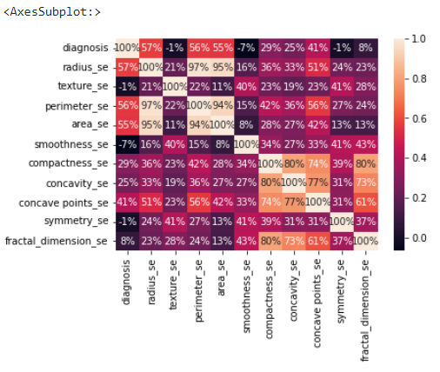
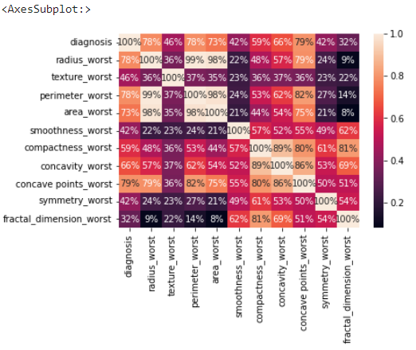
Visualizing Correlation
Visualizing the correlation of diagnosis with different pairs of data using heatmap

Slide 15


Basic Steps:
Split the dataset into independent(X) and dependent(Y) datasets
Split the dataset into training and testing
Model Building
Prediction
Testing model accuracy

Slide 16

Results after applying Machine Learning
The breast cancer database consists of total 30 conditional attributes. We have made total three different cases which means that we can give three different group of inputs to get diagnosed by out model.
In the first group we have taken all the 30 features which will give the most accurate results but we need to fill it up with 30 inputs. Best accuracy is given by Random Forest Classifier model that is of 96.4%.
The next group is result of feature engineering we have done and contains the main motive of our project. In this we will fill 9 inputs to get the results in less time and using less expenditure for emergency situation. This will be a great support for our medical system. These 9 inputs are having best correlation with diagnosis feature and will be most accurate. In this random forest classifier gave the best accuracy that is of 97.3%.
The next group which contains other 9 features has given best accuracy with Logistic Regression model that is of 94.7%.

Slide 17


There are main 10 features. These 10 are interrelated which we found out from heat-maps. Then we came to know that they are interrelated according to medical aspect also. This is the reason we have chosen only 5 main features by which we excluded 5 other features and saved lot of time and expenditure.

Slide 18

THE END
Thank you for your attention

